Slide 1


AI in Construction Cost Management
Enhancing Estimation Accuracy and Mitigating Risks in Residential and Infrastructure Projects
Presenter:
Presented to :
Mostafa Abdellatif - 23227500
Prof. Ahmed El seddawy
Notes:
Good morning. We're here to discuss a critical shift in construction: how AI is revolutionizing cost management. This isn't just about new tech; it's about fundamentally enhancing accuracy and mitigating risks in every project we undertake. We'll explore how AI moves us beyond traditional, often subjective, estimation methods. This strategic shift promises greater financial predictability for both residential and infrastructure endeavors. Let's dive into the current challenges facing our industry.

Slide 2
Problem analysis and Business Understanding
40%+
Industry Reality
The construction sector is a cornerstone of the country’s GDP, but it is plagued by market volatility and productivity fluctuations.
over $1 billion
The Problem
Traditional estimation methods are often prone to inaccuracies, creating budget overruns, delays, disputes, and project risk.
Average cost overruns in large-scale megaprojects globally.
Consequences
Financial instability, stakeholder disputes, and reduced ROI that threaten project viability and economic growth.
Notes:
The construction industry, a bedrock of global GDP, faces a persistent crisis: chronic cost overruns. This isn't a minor issue; it's a systemic problem. Traditional estimation relies heavily on historical data and expert judgment, which are inherently subjective and prone to optimism bias. The consequences are severe: average cost overruns exceeding 40% in megaprojects, leading to financial instability, stakeholder disputes, and reduced ROI. This unsustainable reality demands a new approach, and that's where AI steps in.

Slide 3
Data Analytics
STUDY SCOPE
300
A comparative quantitative analysis evaluating the effectiveness of AI-driven cost estimation against traditional manual methods across diverse sectors.
KEY DATA POINTS
Diverse construction projects analyzed in the study.
Project Complexity
Financial Estimates
Actual Final Costs
Inflation Rates
Material/Labor Data
Risk Scores
PRIMARY OBJECTIVE
To bridge the research gap by quantifying the reduction in budget overruns and accuracy improvements using large-scale empirical datasets.
Notes:
To validate the power of AI, we conducted a comprehensive quantitative study. Our scope involved a comparative analysis of 400 diverse construction projects, spanning both residential and infrastructure sectors. We meticulously gathered key data points, including project complexity, financial estimates versus actual costs, inflation rates, and risk scores. Our primary objective was clear: to quantify the performance gap between traditional methods and these advanced AI-driven models. This rigorous methodology ensures our findings are robust and actionable. And what did we find regarding accuracy?

Slide 4
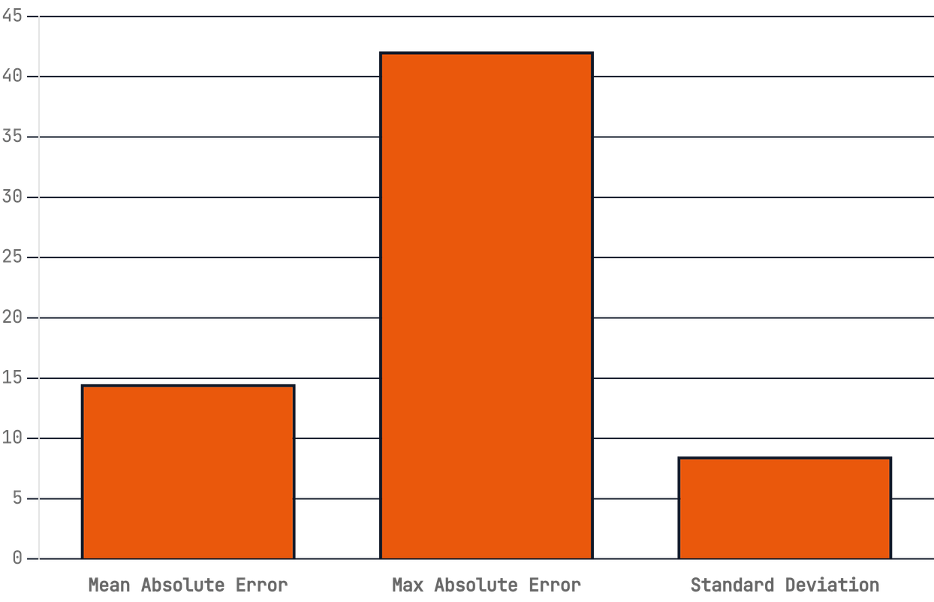
THE COST OVERRUN CRISIS (DATA VIEW)
TRADITIONAL ESTIMATION ERROR DISTRIBUTION
PRIMARY ROOT CAUSES:
- Inaccurate quantity takeoffs - Market price fluctuations - Design inconsistencies - Human estimation bias
*Mean Absolute Error (MAE) stands at 14.5%, with catastrophic outliers reaching up to 42.1% in high-complexity projects.

Slide 5
AI & DATA ANALYTICS APPLICATION
MACHINE LEARNING
DEEP LEARNING
PROBABILISTIC
REGRESSION & XGBOOST
ANNs & LSTMs
Identifies non-linear cost drivers such as project size, location, and market trends from historical datasets.
BAYESIAN NETWORKS
Artificial Neural Networks model intricate patterns, while LSTMs forecast costs over time considering project phases.
Models dependencies between cost factors and risk events to provide nuanced assessments.
RANDOM FORESTS
MULTI-MODAL AI
MONTE CARLO
Handles complex interactions between features to improve predictive accuracy and reduce overfitting.
Integrates numerical data with textual specifications using NLP (GPT-based systems) for risk extraction.
Runs thousands of simulations to generate a range of possible outcomes with associated probabilities.
USE CASE
USE CASE
USE CASE
Initial budget forecasting based on structural parameters.
Dynamic lifecycle cost adjustments and contract analysis.
Quantifying uncertainty and contingency buffer planning.
Notes:
So, how do we tackle this crisis? The answer lies in the AI revolution in estimating. We're moving from manual calculations to sophisticated, data-driven predictive modeling. This involves powerful machine learning algorithms like XGBoost and Random Forests to uncover complex patterns in project data. We also leverage deep learning, specifically LSTM and ANNs, to model sequential project lifecycles and predict cost trajectories. Furthermore, probabilistic models, such as Bayesian networks, quantify uncertainty, providing a range of potential cost outcomes for better contingency planning. This isn't just about individual technologies; it's about their synergistic integration with BIM and robotics for end-to-end automation. Now, let's look at how we've rigorously tested these AI models.

Slide 6
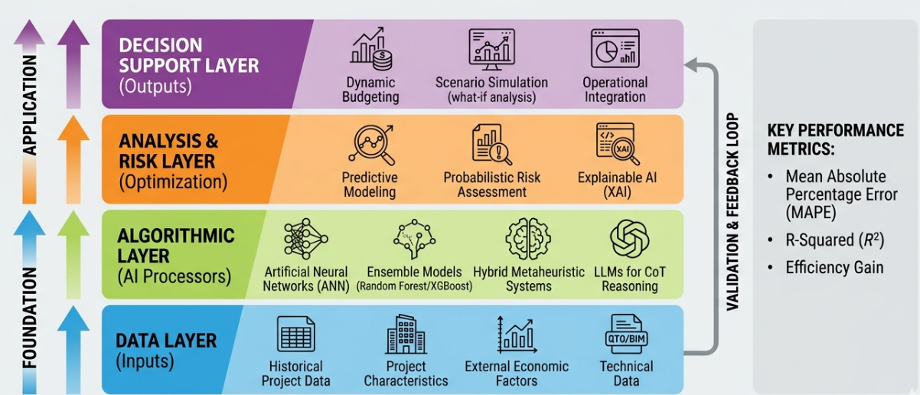
The AI Cost Estimation Pipeline

Slide 7
DIGITAL TRANSFORMATION ANALYSIS
PERFORMANCE
INFRASTRUCTURE
EXECUTION
BIM INTEGRATION
EFFICIENCY GAINS
ROBOTICS & AUTOMATION
Building Information Modeling (BIM) provides the structured geometric and material data required for automated quantity takeoffs, eliminating manual measurement errors.
AI-driven robotics optimize resource allocation and perform predictive maintenance, ensuring operational cost stability and reducing labor-related overheads.
AI-powered estimation workflows accelerate bid submissions and decision-making by automating complex data processing tasks.
97%
73%
7X
ACCURACY POTENTIAL
ERROR REDUCTION
FASTER ESTIMATION

Slide 8
ERP Integration
AI AS THE INTELLIGENCE LAYER
AI acts as a dynamic bridge between BIM (Design) and ERP (Finance), syncing real-time pricing databases and economic indicators to create a "Single Source of Truth."
DATA INPUT
AI ANALYSIS
ERP SYNC
FEEDBACK
Historical & Real-time
Pattern Recognition
Budget Optimization
Continuous Learning
CONTRACTORS
MANAGERS
OWNERS
Real-time monitoring against budget and proactive risk identification.
Realistic financial planning and reduced capital lock-up in contingency buffers.
Competitive and profitable bidding with 7x faster estimation speed.

Slide 9
Accuracy Redefined: MAPE Results
TRADITIONAL METHODS
AI-DRIVEN MODELS
14.50%
10.25%
Baseline error rate using historical averages and expert judgment, often skewed by optimism bias.
Enhanced precision through multi-modal data analysis and non-linear pattern recognition.
Notes:
Our research redefined accuracy, as evidenced by our Mean Absolute Percentage Error, or MAPE, results. Traditional methods showed a significant 14.50% MAPE, reflecting the inherent optimism bias and variability. In stark contrast, our AI-driven models achieved a remarkable 10.25% MAPE. This isn't just a marginal improvement; it's a substantial reduction in error. This enhanced precision comes from multi-modal data analysis and the ability of AI to recognize non-linear patterns. This means AI provides a far more reliable financial baseline, significantly reducing the variance between estimated and actual costs. Next, we'll quantify the financial impact of this improved accuracy.

Slide 10
Financial Impact: The Overrun Gap
METRIC
TRADITIONAL
AI-DRIVEN
Potential Savings
Total Portfolio Overrun
$44.3 Million
$9.1 Million
$35.2M
Overrun Percentage
9.20%
2.10%
Accuracy (MAPE)
14.50%
10.25%
Identified reduction in budget overruns across the 300-project study by transitioning to AI-driven estimation frameworks.
Notes:
We've seen how AI refines accuracy; now let's translate that into tangible financial gains. The impact on budget overruns is simply staggering. Our study shows a nearly fourfold reduction in total budget overruns when using AI-driven estimation. This means moving from a 9.2% overrun to just 2.1%, saving a remarkable $35.2 million across the portfolio. That's real money, directly impacting your bottom line. And it's a clear indicator of AI's power to mitigate financial risk. But the benefits extend beyond just cost savings; they also touch on how we operate.

Slide 11
Operational Efficiency and Speed
7x
Accelerated Decision Making
Rapid generation of cost estimates allows project managers to evaluate multiple design scenarios and market fluctuations in real-time.
BIM-AI Automation
Faster estimation compared to traditional human-led processes.
Direct integration with Building Information Modeling (BIM) enables automatic quantity takeoffs, virtually eliminating manual data entry errors.
Resource Optimization
Human estimators can shift focus from repetitive calculations to high-value strategic risk analysis and value engineering.
Notes:
Beyond the financial impact, AI fundamentally transforms operational efficiency and speed. We're talking about generating estimates up to seven times faster than traditional human-led processes. This speed enables accelerated decision-making, allowing project managers to quickly evaluate multiple scenarios. And with BIM-AI automation, we virtually eliminate manual data entry errors, freeing up human estimators. They can then focus on high-value strategic analysis, not repetitive calculations. This efficiency creates a ripple effect, benefiting every stakeholder involved.

Slide 12
Strategic Stakeholder Benefits
Project Owners
Contractors
Gain unprecedented financial certainty and improved capital allocation through reliable budget forecasting and risk mitigation.
Submit more competitive and accurate bids, protecting profit margins and reducing the likelihood of costly disputes.
Financial Institutions
Architects & Engineers
Receive more reliable project appraisals and risk assessments, leading to reduced investment risk and better loan terms.
Utilize early cost feedback loops to optimize designs for cost-effectiveness without compromising on functionality or aesthetics.
Notes:
The strategic benefits of AI in cost management extend across all key stakeholders. Project owners gain unprecedented financial certainty, leading to better capital allocation. Contractors can submit more competitive and accurate bids, protecting their profit margins. Financial institutions see reduced investment risk through more reliable project appraisals. And architects can optimize designs for cost-effectiveness with early, precise feedback. Ultimately, this creates a more collaborative and financially sound ecosystem for everyone. But it also elevates our ability to manage risk itself.

Slide 13
Risk Management and AI
BEYOND NUMBERS
AI identifies subtle risk patterns across multiple dimensions, such as correlating inflation spikes with material supply chain delays that traditional methods miss.
STRATEGIC SHIFT
From Reactive Auditing to Proactive Intelligence.
PROACTIVE WARNINGS
Early warning systems provide real-time alerts for potential budget deviations, allowing for immediate corrective action before costs spiral.
AI-driven risk management transforms cost control from a "look-back" exercise into a forward-looking strategic advantage.
PROBABILISTIC CONTINGENCY
Setting realistic contingency funds based on data-driven confidence intervals rather than arbitrary industry-standard percentages.
Notes:
AI truly redefines risk management, moving us from reactive auditing to proactive intelligence. It goes beyond simple numbers, identifying subtle risk patterns that traditional methods often miss. Think about correlating inflation spikes with material supply chain delays; AI spots these connections. This capability provides early warning systems for potential budget deviations, allowing for immediate corrective action. And it enables us to set realistic contingency funds based on data-driven confidence intervals, not arbitrary percentages. This shift is a strategic advantage, transforming how we approach project uncertainties. However, implementing such a powerful system isn't without its challenges.

Slide 14
Challenges to Implementation
04
Data Quality & Fragmentation
High Initial Investment
AI models are highly dependent on high-quality historical data. The construction industry suffers from fragmented, non-standardized data silos.
Significant upfront costs for technology infrastructure, software licensing, and specialized talent acquisition can be a barrier for smaller firms.
Critical hurdles that must be addressed to unlock the full potential of AI-driven cost management.
Cultural Resistance
Ethics & Regulatory Barriers
Resistance to change from traditional estimators and project managers who may perceive AI as a threat to their professional expertise.
Questions regarding accountability for AI-generated errors, data privacy, and the need for clear legal frameworks in construction contracts.
Notes:
While AI offers immense benefits, we must acknowledge the critical hurdles to its widespread adoption. These challenges aren't insurmountable, but they demand strategic foresight and investment. First, data quality is paramount; AI models are only as effective as the data they consume, and our industry's data is often fragmented. Second, the initial investment in technology and talent can be substantial, posing a barrier for some firms. And finally, we face cultural resistance from those accustomed to traditional methods, along with ethical questions around AI accountability. Addressing these points will be key to unlocking AI's full potential. But what does this future look like?

Slide 15
The Future: Generative AI and Digital Twins
Generative Design-to-Cost
Digital Twin Synchronization
The Evolution of Autonomous Construction Management
AI optimizes design options to meet budgets efficiently.
Syncs physical sites with virtual models to spot cost deviations fast.
Predictive Robotic Maintenance
Predicts equipment issues to cut downtime and costs.
STRATEGIC HORIZON: INTEGRATING REAL-TIME DATA WITH PREDICTIVE INTELLIGENCE
Notes:
Building on the foundation of AI-driven cost management, the future promises even more transformative applications. We're moving towards autonomous construction management, where AI isn't just predicting costs but actively shaping projects. Generative AI will optimize designs to meet budget constraints from the outset. Digital twins will provide real-time synchronization between physical sites and virtual models, instantly flagging cost deviations. And predictive robotic maintenance will drastically reduce equipment downtime, saving significant operational costs. This strategic horizon integrates real-time data with predictive intelligence, creating a truly dynamic environment. So, what are our key takeaways and recommendations?

Slide 16
Future directions and Recommendation
RECOMMENDATION 01
Standardize Data Collection
Invest in high-quality, structured historical data collection to fuel more accurate predictive models.
AI is no longer a luxury but a strategic necessity for financial predictability and risk mitigation in the modern construction landscape.
RECOMMENDATION 02
Foster Cross-Domain Synergy
Bridge the gap between AI specialists and domain experts to ensure models are grounded in construction reality.
RECOMMENDATION 03
Adopt Probabilistic Frameworks
Transition from static estimates to probabilistic frameworks that account for market volatility and project risks.
Notes:
In conclusion, AI is no longer a luxury; it's a strategic imperative for financial predictability and risk mitigation in construction. To capitalize on this, we have three core recommendations. First, we must invest in standardizing and collecting high-quality data to fuel more accurate predictive models. Second, fostering collaboration between AI specialists and construction domain experts is crucial to ensure our models are grounded in reality. And finally, we need to transition to probabilistic estimation frameworks that account for market volatility and project risks. The future of construction is undeniably data-driven, resilient, and efficient.

